Slide 1
TEAM 5 PentaBrain
2019 Cityhack Theme 2 solution

Slide 2
Process
Test our original codes in Terminal
Integrate our code using Python
Run the program in Terminal, which will scan through all targeted Annual Report files
The program will show all the data containing the keywords we typed in

Slide 3
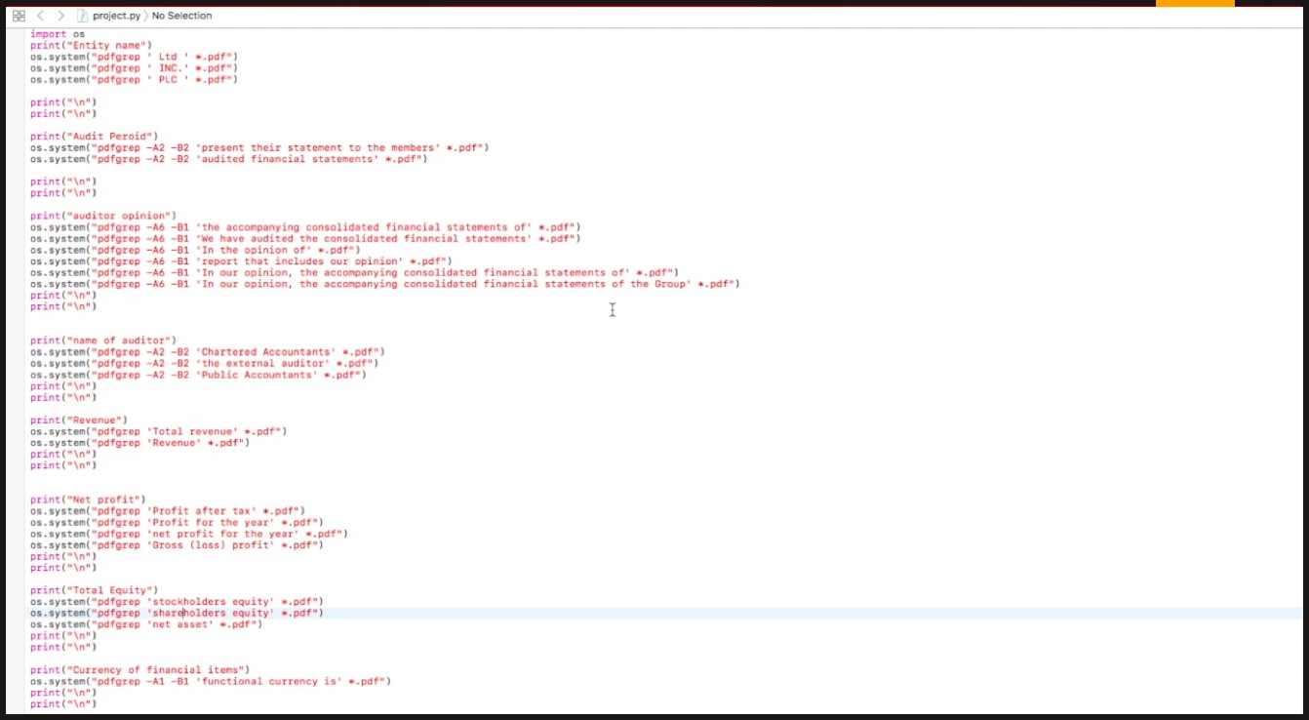
Demonstration

Slide 4
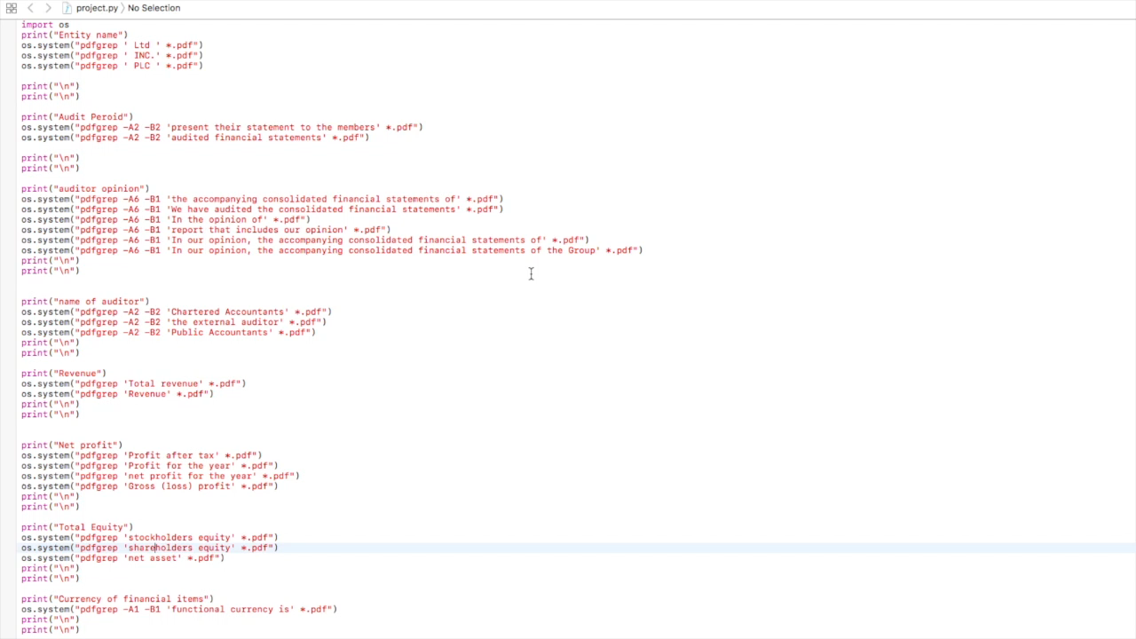
Demonstration

Slide 5




Use-cases& User benefits
School
Individual
Efficiency
Cost- reduction
Precision
Government
Corporation

Slide 6
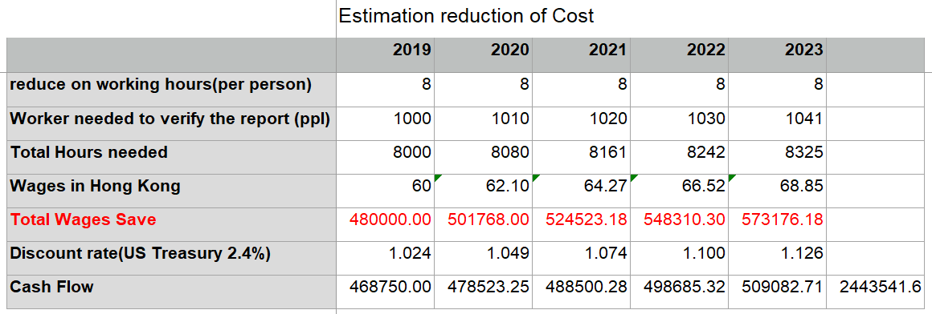
Business model – Cost Reduction
2.5M

Slide 7
Team
Eric Lu
Shawn Tai
Ryan Yen
Kyle Cheng
Leo Wang
Frontend Developer (56276778)
Backend Developer
Backend Developer
Marketing Guru
Accounting Guru, Backend Developer

Slide 8
Q&A

